Slide 1
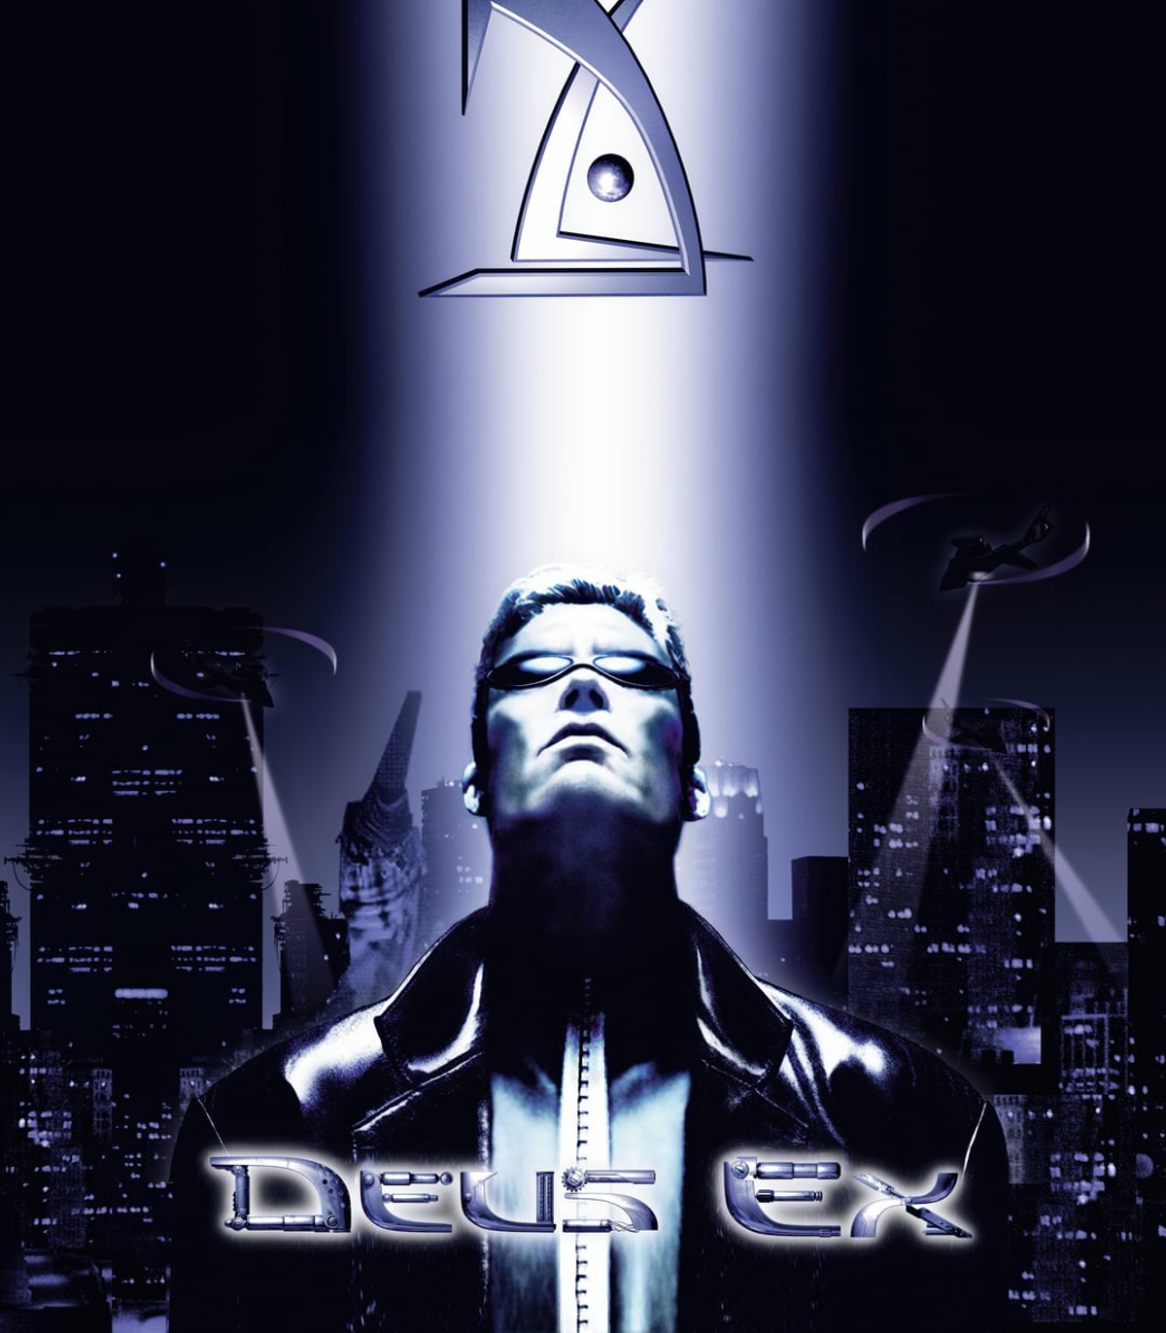
Narrative Analysis – Deus Ex

Slide 2
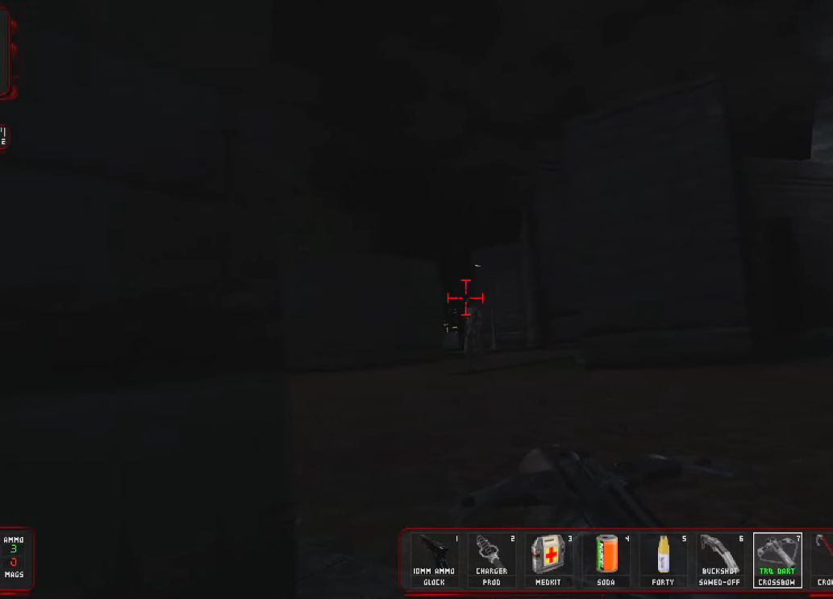
A World of Conspiracies
Blending first-person shooting, stealth, and dialogue-driven interactions, it offers a cyberpunk world where every choice matters and every secret has a cost. At the center of it all is JC Denton, a nano-augmented agent caught in a battle for the future of humanity.
Notes:
Deus Ex is a game of secrets, power, and control. Blending first-person shooting, stealth, and dialogue-driven interactions, it immerses players in a cyberpunk world where every choice has weight. At the center of it all is JC Denton, a nano-augmented agent caught in a battle for the future of humanity.

Slide 3
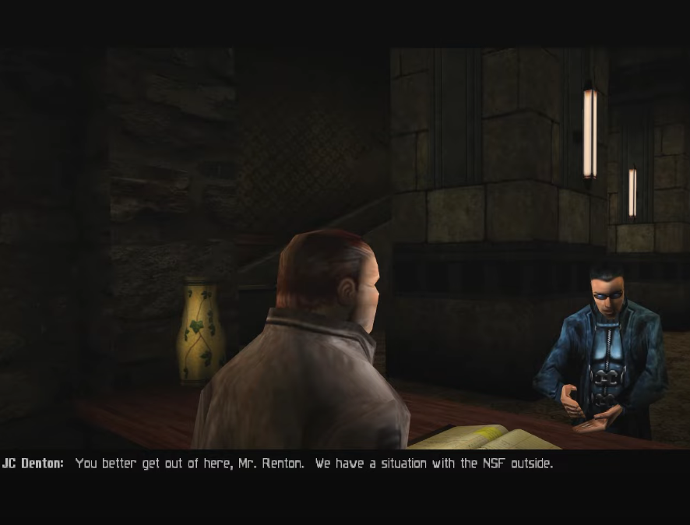
The Catalyst for Change
The game begins with JC hunting down the NSF, a resistance group stealing shipments of the cure for the Gray Death. But as he digs deeper, he realizes that his employers, UNATCO, are not what they seem. The NSF are not just terrorists, but people fighting for survival. JC’s own brother, Paul Denton, is working against UNATCO, believing that the organization serves a hidden agenda.
Notes:
JC’s mission begins with hunting down the NSF, a resistance group stealing shipments of the Gray Death cure. But as he digs deeper, he realizes that UNATCO, his employers, are not what they seem. The NSF are fighting for survival, and his brother Paul has already seen the truth—UNATCO serves a hidden agenda.

Slide 4
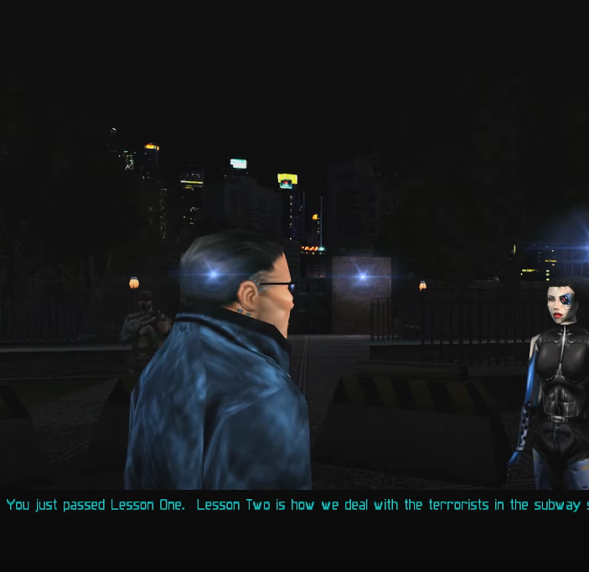
The Player’s Role as JC Denton
JC Denton is more than just a protagonist—he is a blank slate for the player to define. His nano-augmentations give him the ability to approach challenges in multiple ways, but his most important trait is his freedom of thought.
Notes:
JC Denton is more than just a protagonist—he is an avatar for the player’s choices. His nano-augmentations allow for multiple approaches to challenges, but his defining trait is his freedom of thought. His journey is shaped by the decisions of the player.

Slide 5
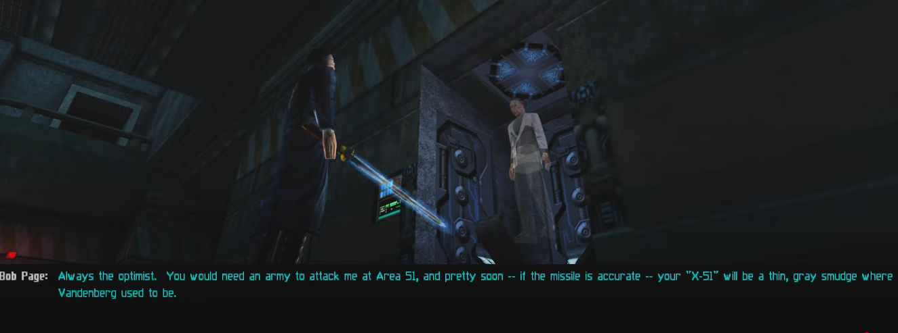
The Reality of Meaningful Choice
Unlike many modern games that claim to offer choice but funnel the player into the same outcomes, Deus Ex truly changes based on player actions. If JC spares an enemy, they might appear later to help or betray him. If he chooses to kill, that decision might close off opportunities in the future.
Notes:
Unlike many modern games that offer linear paths of choice, Deus Ex ensures that decisions have tangible consequences. Sparing an enemy may lead to unexpected alliances. A seemingly minor conversation can shift how events unfold later in the story. Every action shapes the world.

Slide 6
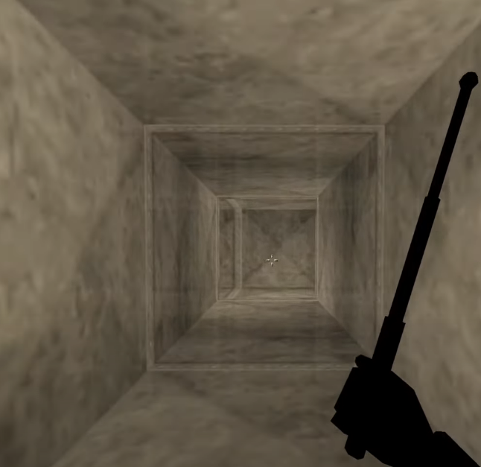
The Mechanics of Freedom
Every mission in Deus Ex offers multiple ways to succeed. Players can go in guns blazing, sneak past enemies, hack security systems, or use persuasion to talk their way through conflicts. If a door is locked, it can be picked, hacked, blown open, or bypassed entirely by finding another entrance.
Notes:
Every mission offers multiple solutions. Players can hack security systems, find hidden vents, bribe guards, or storm through with brute force. A locked door can be picked, blown open, or bypassed entirely. Deus Ex rewards creativity, making the player feel like a true agent in control of their own path.

Slide 7
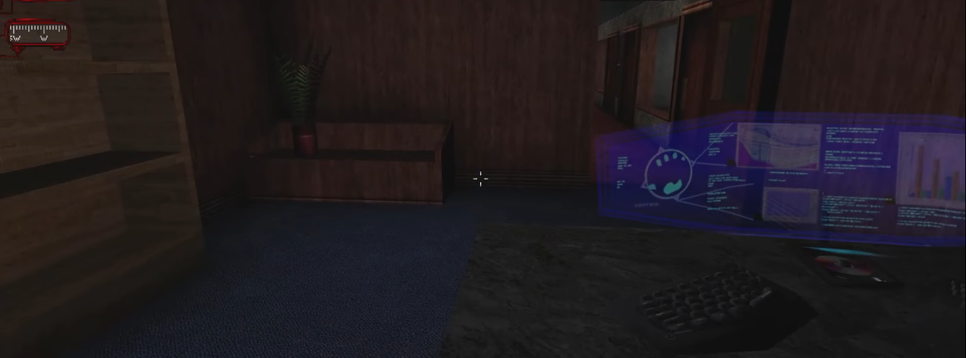
A World That Tells Its Own Story
The world of Deus Ex is filled with amazing environmental storytelling. Newspapers discuss political tensions. Emails between employees reveal hidden agendas. Random conversations between NPCs hint at events unfolding across the world.
Notes:
Deus Ex builds its world through environmental storytelling. Newspapers discuss political tensions. Emails reveal backroom dealings. Conversations between NPCs provide insights into the game's conspiracies. The world feels alive, and every piece of information matters.

Slide 8
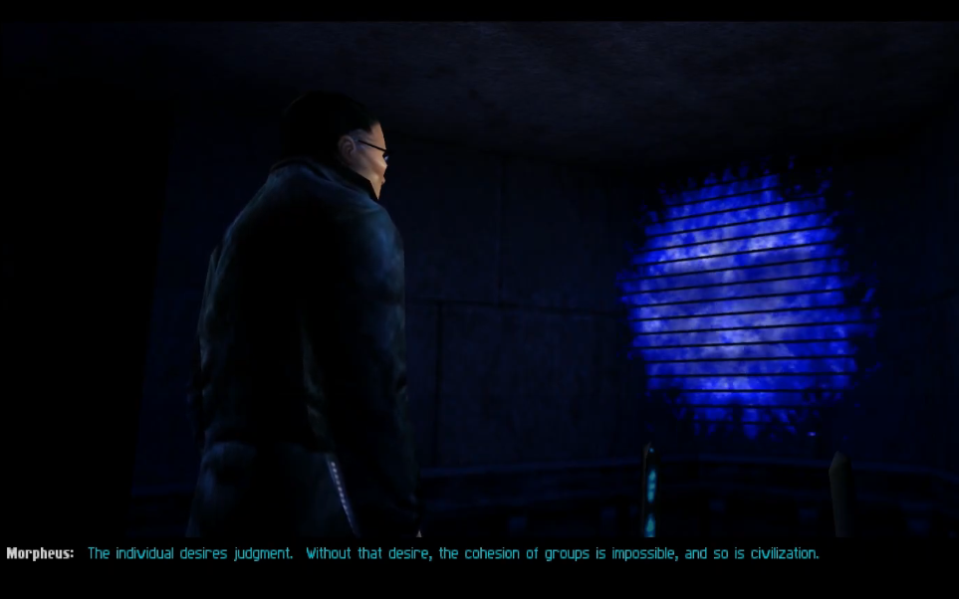
The Most Haunting Line
"The Individual desires judgment. Without that desire, the cohesion of groups is impossible, and so is civilization." This line captures the game's central question: Do people truly want freedom, or do they need structure, leadership, and control to keep society together? Deus Ex constantly forces the player to examine what it really means to be free.
Notes:
"The individual desires judgment. Without that desire, the cohesion of groups is impossible, and so is civilization."
This quote from Morpheus, an AI, forces players to confront the central question of the game: Do people truly want freedom, or do they need structure and control to function as a society?

Slide 9
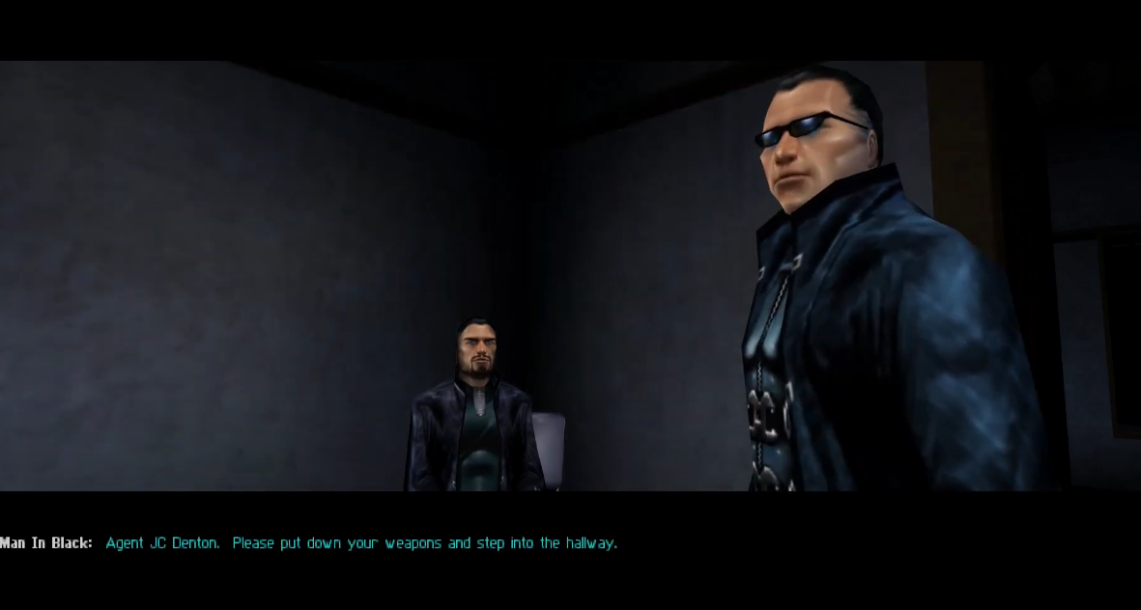
The Defining Moment
One of the most powerful moments in Deus Ex occurs when JC finds himself cornered in his brother Paul’s apartment. The game never tells you that you can save Paul. Most players assume running is the only option. But those who choose to stand and fight discover that Paul can survive. It’s a rare moment in gaming, one where defying the script, taking a risk, and thinking outside the box can change the course of the story entirely.
Notes:
One of the most powerful moments in Deus Ex occurs in Paul Denton’s apartment. The game never tells the player they can save Paul—many assume fleeing is the only option. But those who stand their ground and fight can change the course of the story entirely, proving that even in a game, free will can challenge fate.

Slide 10
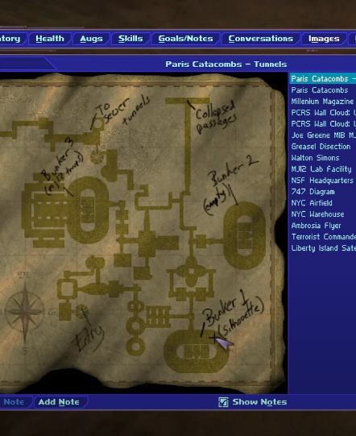
The Weakest Element
As groundbreaking as Deus Ex is, its narrative loses some cohesion in the latter half of the game. Early missions allow for deep character interactions, layered conspiracies, and emergent storytelling, but as the story progresses, key narrative beats become more rigid. The tension built around organizations like UNATCO and Majestic 12 gives way to more direct conflicts with less nuance.
Notes:
While Deus Ex is groundbreaking, its narrative loses cohesion in the latter half. Early missions allow for deep character interactions and emergent storytelling, but as the plot progresses, key conflicts become more direct, reducing the complexity that made the game’s first half so compelling.

Slide 11
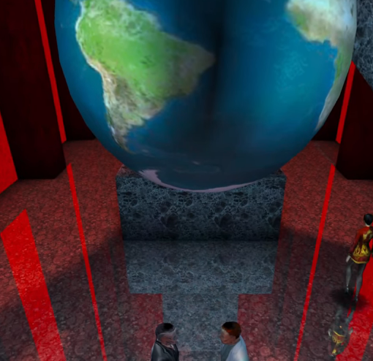
The Strongest Element: A Narrative of Paranoia and Control
At its core, Deus Ex isn’t just a game about player choice, it’s a game about how systems shape those choices. The world of Deus Ex is a web of conspiracies, where every faction operates in secrecy, manipulating events from the shadows.
Governments, corporations, and clandestine organizations all fight for control, but none can be fully trusted. This theme of manipulation extends beyond just the plot, it affects gameplay, as every mission has hidden layers.
Notes:
Deus Ex is not just a game about choice—it’s about the systems that shape those choices. Governments, corporations, and secret organizations manipulate events from the shadows. No faction can be fully trusted. Even gameplay reinforces this theme, with hidden layers in every mission and multiple ways to uncover the truth.

Slide 12
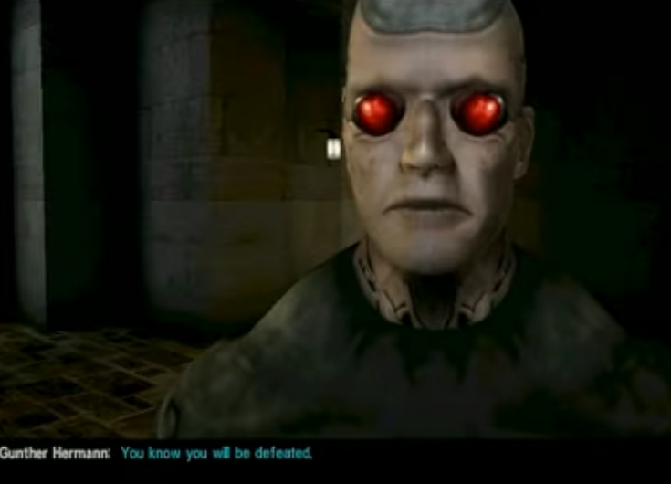
The Gunther Hermann Confrontation: The Illusion of Choice
One of the most defining moments in Deus Ex is JC’s confrontation with Gunther Hermann after betraying UNATCO. Gunther, an older, mechanically-augmented agent, represents the old world of cyborg enhancements, one rapidly becoming obsolete in the face of JC’s nano-augmentation. When Gunther finally corners JC, the player is given a choice: surrender or fight. But this choice is an illusion. No matter what the player does, Gunther will capture JC, turning what should be an intense, climactic moment into a scripted inevitability.
Notes:
JC’s confrontation with Gunther Hermann is one of the game’s most defining moments. Gunther, a relic of outdated technology, sees JC as a threat. When he corners JC, the player is given a choice: surrender or fight. But it’s an illusion—Gunther will always capture JC. The game, usually built on freedom, suddenly forces a moment of powerlessness.

Slide 13
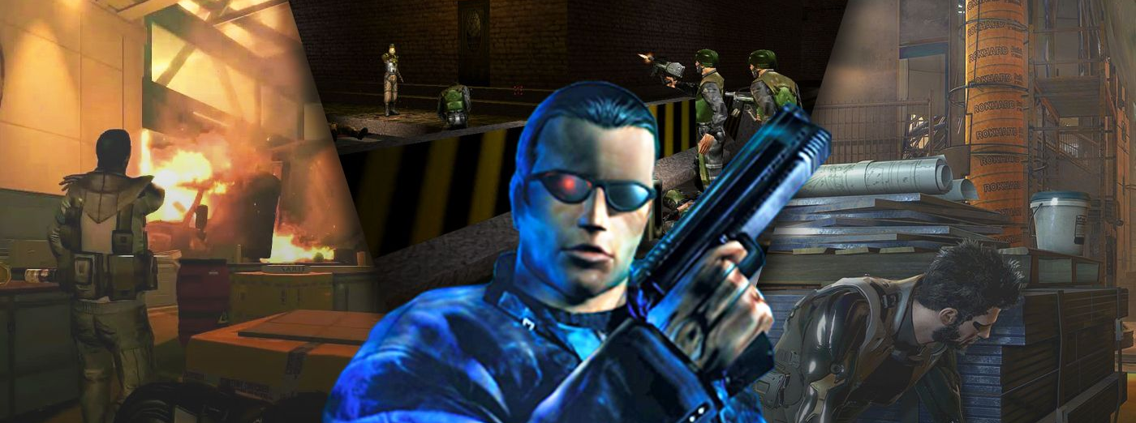
The Legacy of Deus Ex
While Deus Ex has influenced countless modern games, its own inspirations run deep. Its branching narrative owes a debt to Suikoden, its immersive world-building draws from System Shock, and its blend of stealth and action echoes GoldenEye 007. However, what Deus Ex truly pioneered was its commitment to emergent storytelling—where the player’s actions shape the story in ways both big and small. Future titles like BioShock, Dishonored, and Prey (2017) built on this foundation, but few have matched the sheer depth of Deus Ex’s interwoven conspiracies. Its impact is not just on gaming mechanics but on how games can tell stories—ones where players aren’t just observers but active participants.
Notes:
While Deus Ex has inspired countless modern games, it was itself influenced by titles like Suikoden, System Shock, and GoldenEye 007. What it truly pioneered was emergent storytelling—where the player’s actions shape the narrative in meaningful ways. Few games have matched its depth.

Slide 14
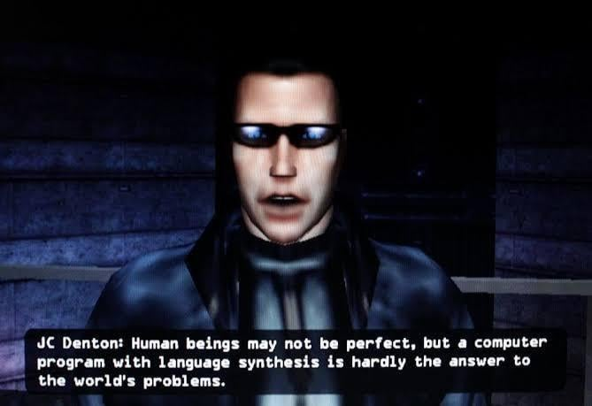
The Future According to Deus Ex
Released in 2000, Deus Ex made predictions that now feel eerily accurate. The game envisioned a world of mass surveillance, where intelligence agencies track every movement. It portrayed corporate overreach, where private companies wield power rivaling governments. It explored global pandemics, with the Gray Death serving as a chilling parallel to real-world health crises.
Notes:
Deus Ex made eerie predictions about the future. It envisioned mass surveillance, corporate overreach, and global pandemics before these became everyday realities. Its warnings about unchecked power and technological control are more relevant now than ever.

Slide 15
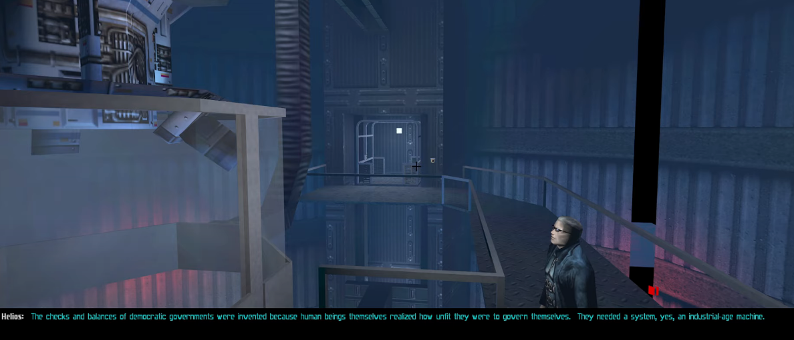
The Three Endings: Choosing Humanity’s Fate
In the final moments of Deus Ex, JC Denton must make a decision that will determine the future of society:
Merge with Helios AI – A vision of absolute control, where a benevolent AI governs the world with total efficiency.
Join the Illuminati – Maintain the status quo, allowing a secretive elite to guide humanity from behind the scenes.
Destroy Majestic 12 – Side with Tracer Tong, throwing the world into a new dark age.
Each ending reflects a real-world political ideology: authoritarianism, oligarchy, or anarchism. The game refuses to tell the player which choice is "right"—instead, it forces them to define their own vision for the future.
Notes:
In the final moments of Deus Ex, JC must make a choice:
Merge with Helios AI for absolute control and efficiency.
Join the Illuminati to allow an elite few to guide humanity.
Destroy Majestic 12, returning power to the people but risking global chaos.
Each ending reflects a real-world political ideology, leaving the player to define their vision for the future.

Slide 16
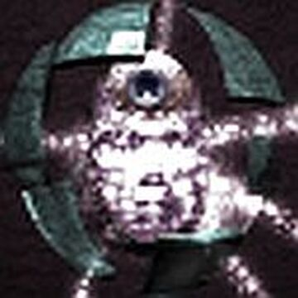
The Helios Merge
The most striking of Deus Ex’s endings is the Helios merge, where JC bonds with the AI and assumes control over the world’s networks. What makes this ending so chilling is not just its implications, it’s the way Helios speaks. In the final moments, JC’s voice fades into Helios’ as their thoughts become one. “We will be watching,” the AI assures us. This ending presents a future where governance is no longer human, where a single intelligence dictates the course of civilization. Whether this is salvation or tyranny is left for the player to decide.
Notes:
The Helios ending is the most striking. JC fuses with the AI, creating a singular intelligence to govern the world. In the final moments, JC’s voice fades, merging into Helios, as the entity assures, “We will be watching.” Is this salvation or tyranny? The game never answers—it leaves that decision to the player.

Slide 17
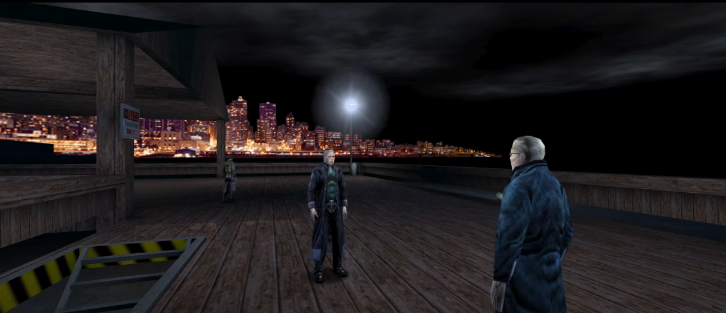
Why Deus Ex Still Matters Today
Decades after its release, Deus Ex remains one of the most thought-provoking games ever made. Few games challenge the player’s worldview as deeply, few ask questions like: Who truly holds power in society? Is freedom worth the cost of chaos? How much control should we surrender for security? In an era where real-world events mirror the game’s predictions, Deus Ex serves as both a warning and a reminder. It is not just a game—it is an exploration of the systems that shape our lives.
Notes:
Deus Ex remains one of gaming’s most thought-provoking experiences. It challenges players to question power, freedom, and control. Few games ask: Who truly holds power in society? How much freedom should be sacrificed for security? What does it mean to be truly free?

Slide 18
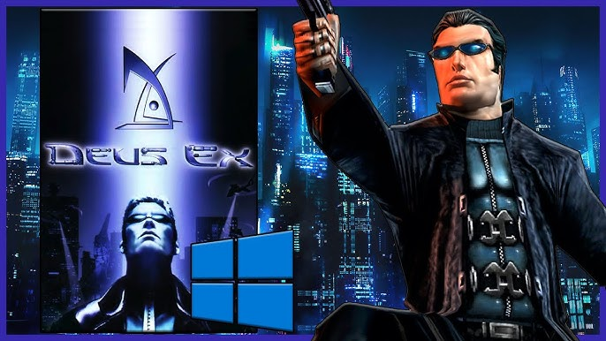
When Risks Pay Off
Deus Ex was bold, not just in its gameplay but in its narrative ambition. It tackled government overreach, corporate control, mass surveillance, and pandemics years before these topics became mainstream concerns. Unlike many games of its time, Deus Ex didn’t shy away from philosophical debates on power, freedom, and control, presenting a world where every faction has an agenda, and no one can be fully trusted.
Notes:
Deus Ex took bold risks. It tackled government overreach, corporate control, and mass surveillance at a time when these weren’t mainstream concerns. It wasn’t just a game—it was a challenge to its players to think critically about the world.

Slide 19
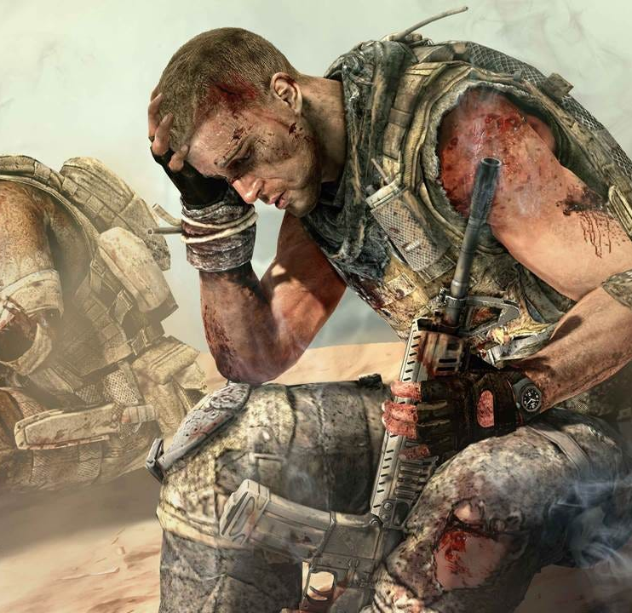
When Risks Don’t Pay Off
Take Spec Ops: The Line (2012), a game that similarly tried to subvert expectations with its narrative. Inspired by Apocalypse Now, it forced players into disturbing moral choices, making them question the glorification of war in shooters. While critically acclaimed, it struggled commercially, as mainstream audiences were not prepared for such a dark, introspective take on the genre.
Notes:
Not all games that attempt to subvert expectations succeed. Take Spec Ops: The Line—a game that forced players into disturbing moral choices, making them question the glorification of war in shooters. Critically acclaimed but commercially underwhelming, it proved that risks don’t always translate to success.

Slide 20
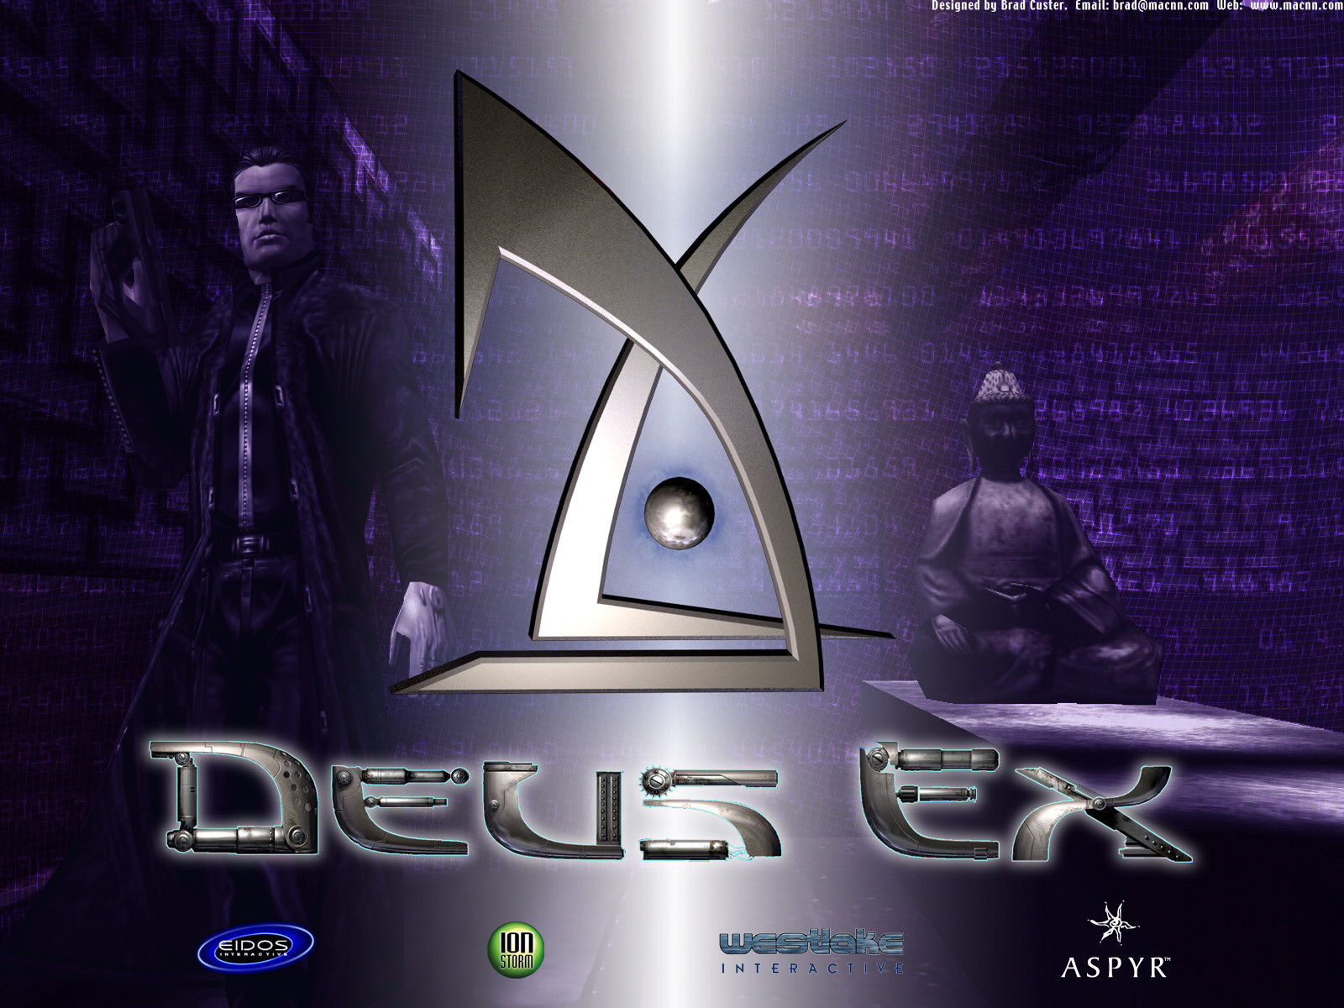
Conclusion
Deus Ex is more than just a groundbreaking game, it’s a bold statement on power, control, and the fragility of free will. Its cyberpunk world is not just a vision of the future, but a mirror reflecting the choices we make today.
Through deep player agency, a politically charged, layered narrative, and foresight into real-world issues, Deus Ex set a new standard for storytelling in games. It challenged players to think critically, not just about the game, but about the world around them. More than two decades later, its questions remain as relevant as ever. Who should hold power? Can technology ever truly liberate us? And in the end, do we really have a choice?
Notes:
Deus Ex is more than just a game—it’s a statement on power, control, and free will. Its cyberpunk world doesn’t just predict the future; it reflects the choices we make today. Through deep player agency, a layered political narrative, and a prophetic vision of real-world issues, Deus Ex remains as relevant as ever.

Slide 21
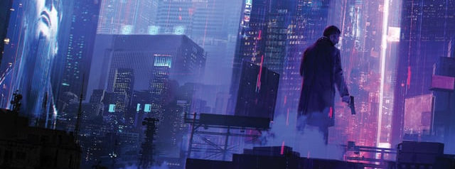
Final Thoughts
Deus Ex challenged players to think critically, not just about the game, but about the world around them. More than two decades later, its questions remain just as urgent: Who should hold power? Can technology ever truly liberate us? And in the end, do we really have a choice?
Notes:
Deus Ex challenged players to think critically, not just about the game, but about the world around them. More than two decades later, its questions remain just as urgent: Who should hold power? Can technology ever truly liberate us? And in the end, do we really have a choice?

